Slide 1

A Study in Remote Work from Leadership and Followership Perspectives
The Double-Edged Sword
By: Dr. Stephanie Diana Eubank
Adjunct Business Administration Instructor at Stan State
Academy of Business Research Online Conference 2026

Slide 2

Presentation Overview
• Background and Motivation
• Literature Review
• Methodology
• Results and Analysis
• Implications and Conclusions

Slide 3

Background of the Problem
• Remote work has rapidly grown
• Most existing studies are 5-10 years old
• Research predominately from leadership perspective
• Limited followership understanding

Slide 4

Problem Statement and Significance
• Gap in understanding how remote team design affects communication and productivity
• Informs better remote team practices
• Bridges leadership-followership perception gap

Slide 5

Conceptual Framework
• Opportunities: Flexibility, Talent Access, Autonomy, Cost Savings
• Challenges: Communication Barriers, Isolation, Coordination Complexity
• Team Design influences communication and productivity

Slide 6

Research Questions
RQ1: What aspects of team design have the greatest effect on productivity among remote teams?
RQ2: What aspects of communication have the greatest effect on productivity among remote teams?
RQ3: What effect does remote work instead of in person work have on team design and how does this affect productivity among remote teams?

Slide 7

Rationale for Methodology
• Qualitative approach
• Individual interviews
• Focus groups
• Nvivo Thematic analysis
Individual Interviews
• Focus Groups
• Descriptive analysis and themes

Slide 8

Dream Team Theory & Apollo Effect
Note: Top-talent “dream teams” don’t guarantee results.
Apollo Effect: all-star teams often underperform.
Balanced team roles beat raw individual ability.
Notes:
Dream Team Theory: the intuitive assumption that assembling the most talented, highest-ability individuals will automatically create the highest-performing team. It frames team success as a simple sum of individual brilliance.
Apollo Effect (Apollo Syndrome): identified by Meredith Belbin in his team-role research, where teams made up entirely of highly capable, analytical people often underperformed. Named after the "Apollo" teams in his management exercises.
Why they struggle: members spend too much time in unproductive debate trying to persuade one another, focus on picking holes in others' arguments, compete for the same tasks, and find it hard to reach and commit to decisions. Routine but necessary work gets neglected.
Key takeaway: high performance depends on a balance of complementary team roles and behaviors, not raw individual talent alone. Emphasize this contrast when discussing how the study frames team composition.

Slide 9

Communication Findings
Communication emerged as a key driver of productivity
Microsoft Teams and Zoom improved collaboration
Regular communication reduced isolation
Communication quality mattered more than communication volume

Slide 10

Team Design Findings
Team design was rarely intentional in remote environments
Few participants observed active team redesign
Dream Team concepts were present but inconsistent
Apollo Effect may create communication and collaboration challenges when teams rely heavily on SMEs

Slide 11
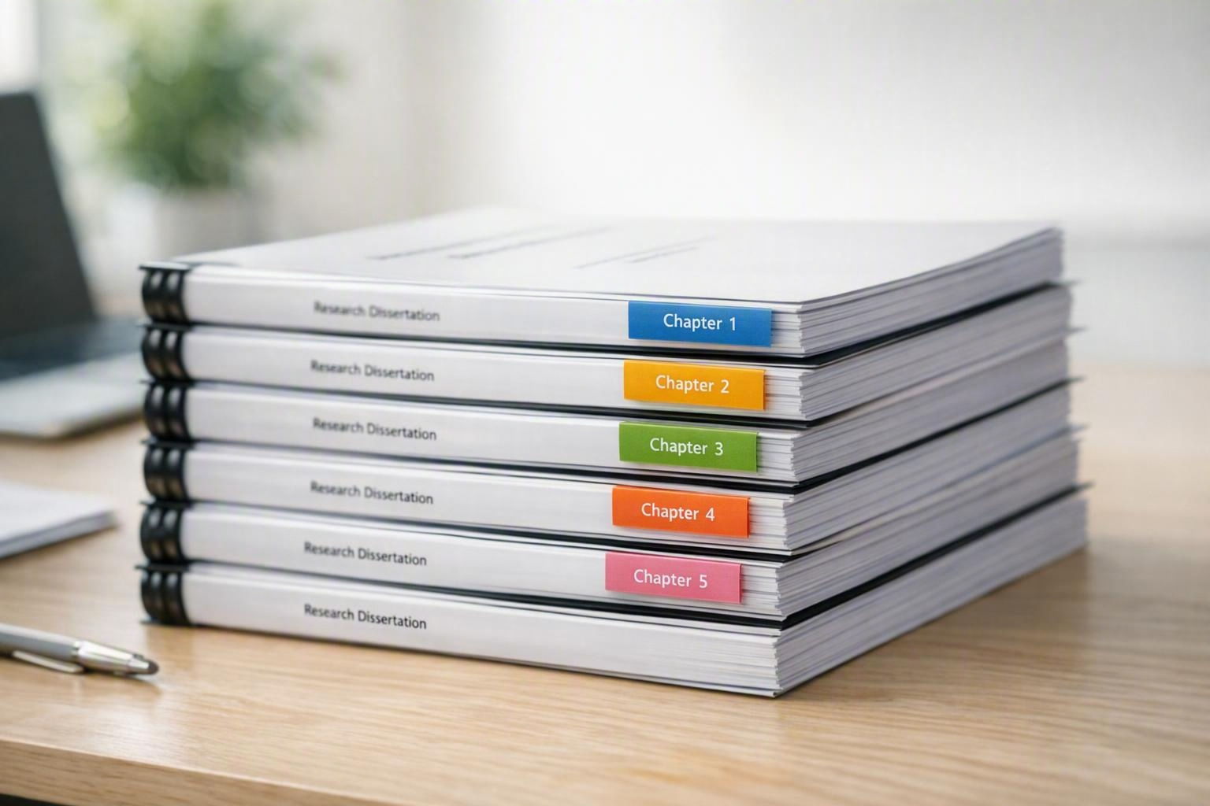
Productivity Findings
Followers generally felt productive remotely
Productivity metrics were often viewed as vague
Followers wanted greater transparency in performance evaluation
Followers also wanted clarity on how leadership is measured
Leaders questioned why managers are not considered followers
Leaders understood leadership evaluation expectations
Leaders were less clear on how their own productivity was measured
Debate emerged between experienced remote leaders and newer remote leaders regarding X and Y Theory leadership approaches

Slide 12

The Double-Edged Sword
Leadership and followership perceive remote work differently
Different views on productivity
Different views on advancement opportunities
Different views on communication effectiveness
Evidence of a persistent perception gap

Slide 13

Major Themes
Strong preference for maintaining remote work flexibility
Experienced remote workers showed stronger adaptation
Disconnect between leaders and followers
Transparency and accountability concerns
Few participants wanted a mandatory return to office

Slide 14

Implications for Practice
Improve transparency in productivity measurement
Clarify expectations for both leaders and followers
Develop remote-specific leadership skills
Incorporate intentional team design practices
Continue research on Dream Teams and the Apollo Effect

Slide 15

Conclusions
• Remote work is here to stay
• Communication remains central to productivity
• Leadership and followership perspectives differ significantly
• Team design remains underutilized
• Additional research is needed to bridge the gap between leaders and followers

Slide 16





Questions

